Slide 1
One Minute Tracking

Slide 2











User Journey
Sales order
Sales order No.
or
Purchase order No.
Purchase order
-update status
-package/prod.
-driver’s inf.
Sales order

Slide 3

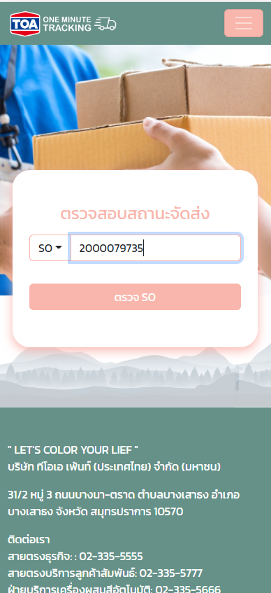
PHASE I
1
Easy to use
2
Real time data
3
Responsive Design

Slide 4
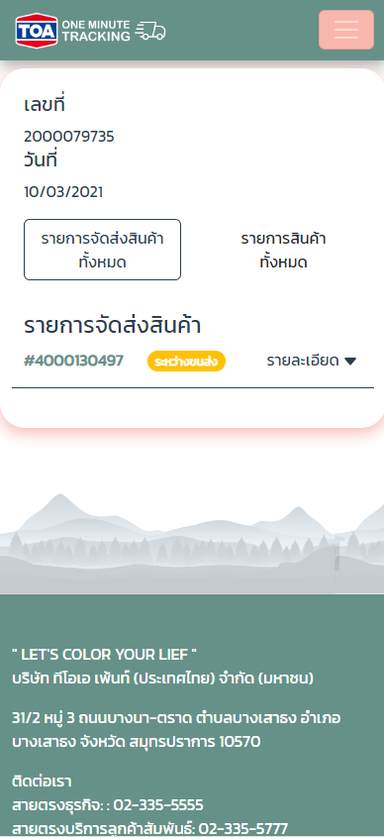
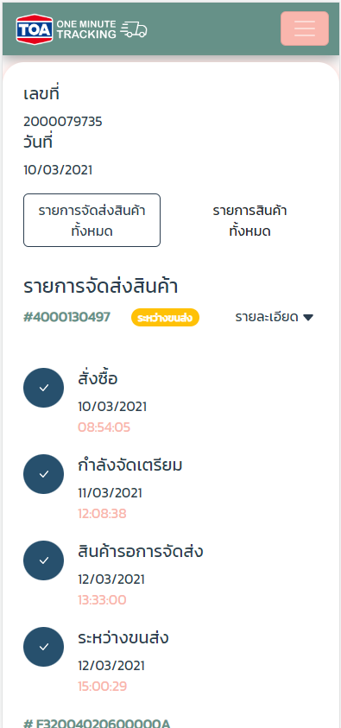
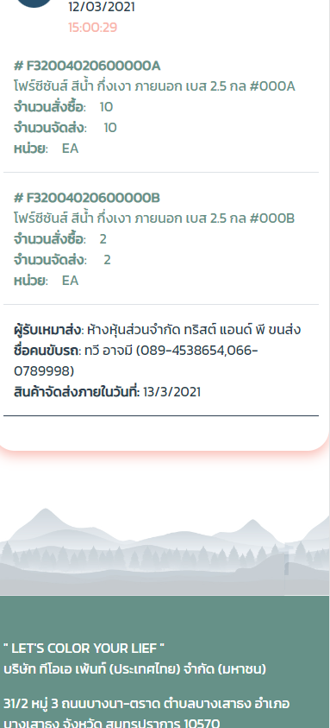
PHASE I
Search
Display
Tracking
Detail

Slide 5
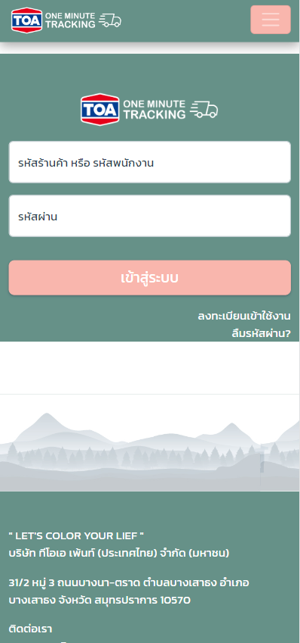
PHASE II
1
Deep in details
2
Security & Authorization
3
Multi Tracking Sales Order

Slide 6
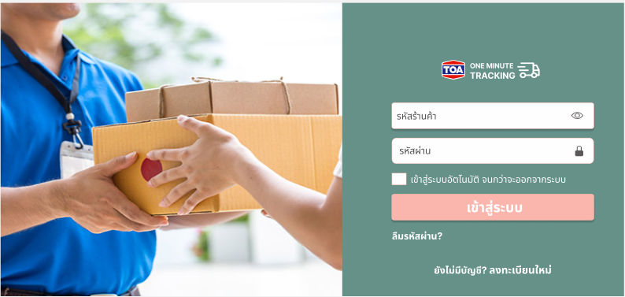
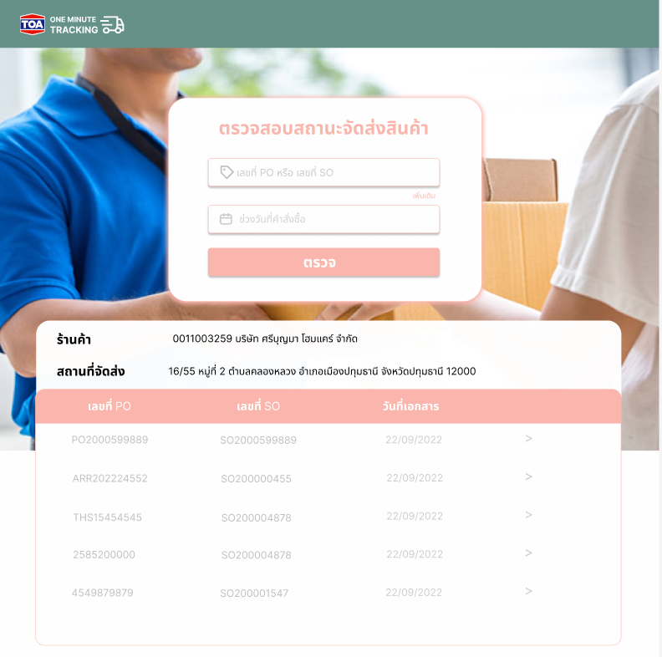
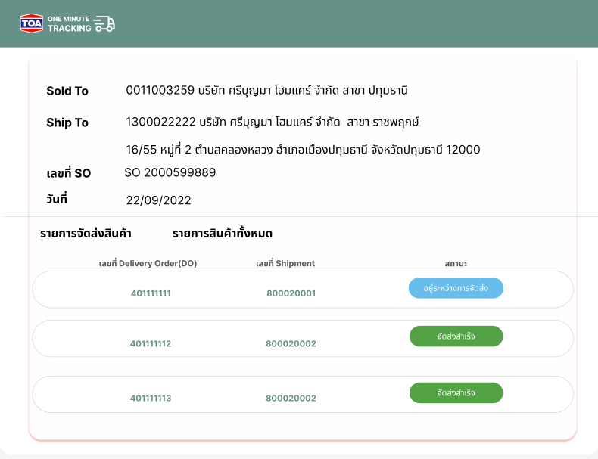
PHASE II-Desktop Design
Register & Log-in
Display sales order
Specific Tracking Order

Slide 7
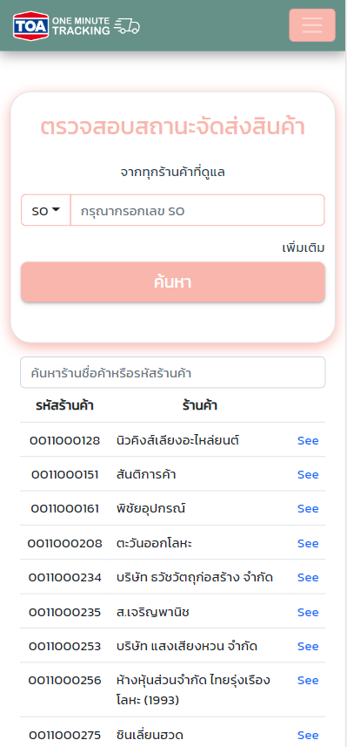
PHASE II-Mobile Design
Register & Log-in
Display sales order
Specific Tracking Order

Slide 8
PHASE II-Register
Salesman
System
Customer
Salesman
System
Request
New register
inform for request account
(send an email)
Request
New register
Register
Register
User Account
Password
Approve
Verify
From DB
User Account
Password
Approve
Verify
From DB
Reject
Reject
Contact admin
Contact admin
Noted
Existing E-ordering customer can login and use logistic tracking status within e-ordering system

